Slide 1
IT- 601: Computer Graphics
Lecture-07
Two –Dimensional Viewing and Clipping

Slide 2
Introduction
window
  a world-coordinate area selected for display
  define what is to be viewed
view port
  an area on a display device to which a window is mapped
  define where it is to be displayed
  define within the unit square
  the unit square is mapped to the display area for the particular output device in use at that time
windows & viewport
  be rectangles in standard position, with the rectangle edges parallel to the coordinate axes

Slide 3
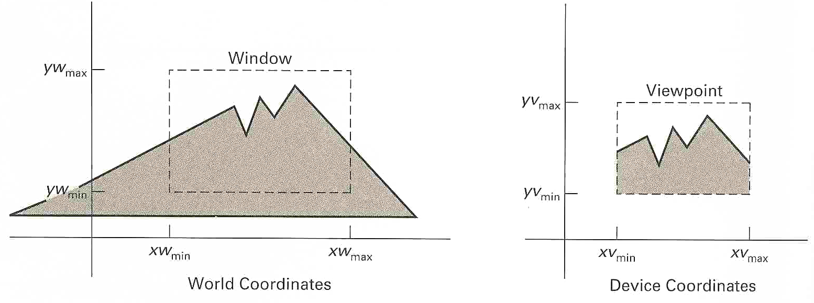
Introduction
viewing transformation
  the mapping of a part of a world-coordinate scene to device coordinates
  2D viewing transformation = window-to-viewport, windowing transformation

Slide 4
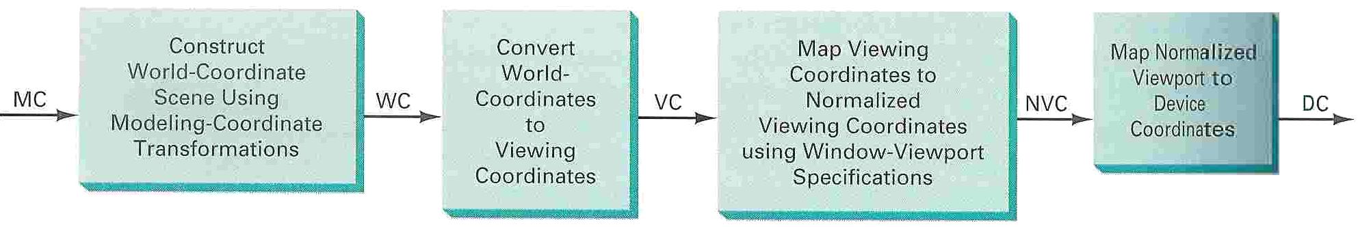
Introduction
viewing-transformation in several steps
  construct the world-coordinate scene
  transform descriptions in world coordinates to viewing coordinates
  map the viewing-coordinate description of the scene to normalized coordinates
  transfer to device coordinates

Slide 5
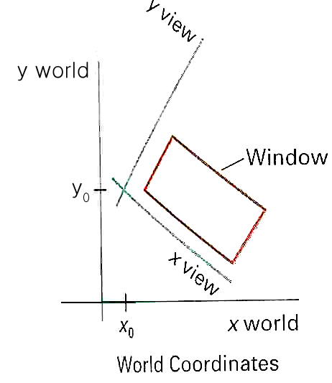
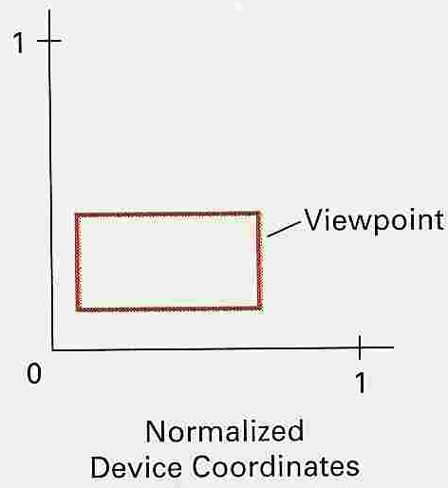
Introduction
viewing-transformation
  by changing the position of the viewport
    can view objects at different positions on the display area of an output device
  by varying the size of viewports
    can change the size and proportions
    of displayed objects
    zooming effects

Slide 6
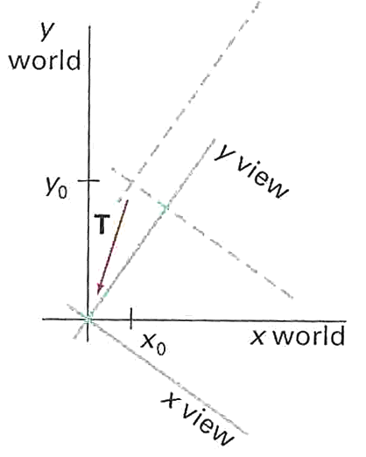
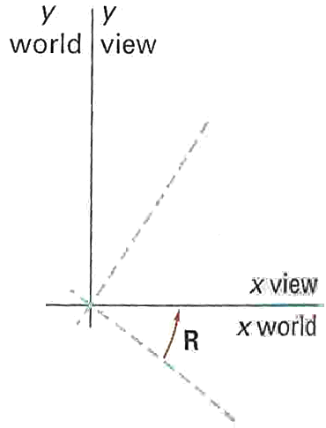
Viewing coordinate reference frame
The composite 2D transformation to convert world coordinates to viewing coordinates
  M_{WC,VC} = R • T

Slide 7
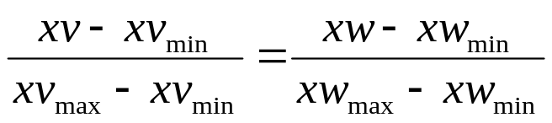
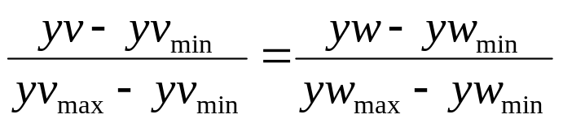
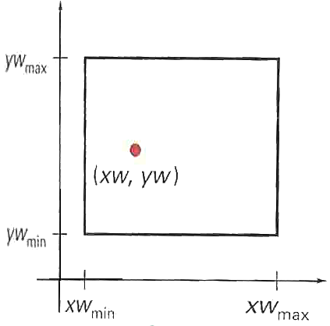
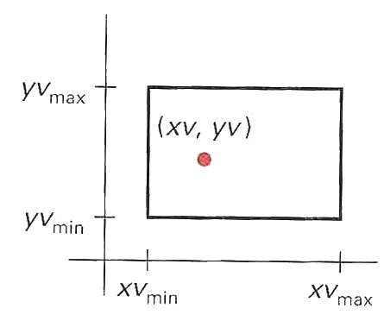
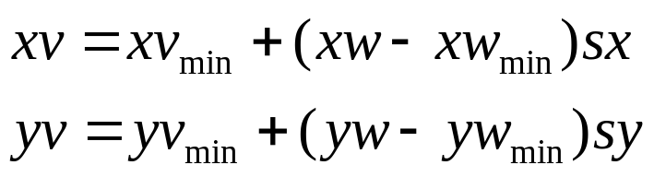
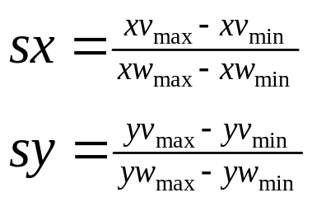
Window-to-viewport coordinate transformation
transfer to the viewing reference frame
  choose the window extents in viewing coordinate
  select the viewport limits in normalized coordinate
to maintain the same relative placement in the viewport as in the window
Thus Where,

Slide 8
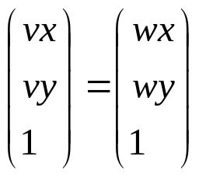
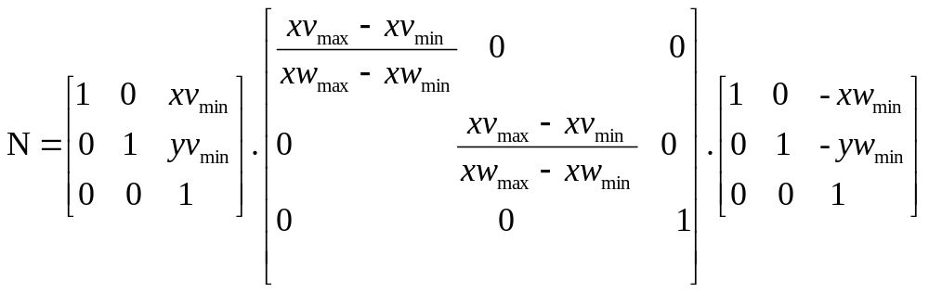
Window-to-viewport coordinate transformation
Eight coordinate values that define the window and the viewport are just constants.
Express these two formulas for computing (vx,vy) from (wx,wy) in terms of a translate-scale-translate transformation N.
where

Slide 9
Clipping Operations
Clipping
  Any procedure that identifies those portions of a picture that are either inside or outside of a specified region of space
Applied in World Coordinates
Adapting Primitive Types
  Point
  Line
  Area (or Polygons)
  Curve
2001. 7. 13

Slide 10
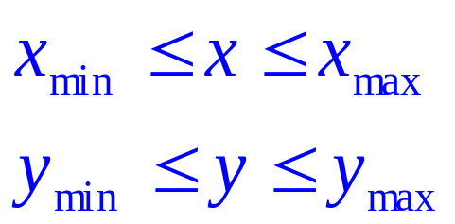

Point Clipping
Assuming that the clip window is a rectangle in standard position
For a clipping rectangle in standard position, we save a 2-D point P(x,y) for display if the following inequalities are satisfied:
If any one of these four inequalities is not satisfied, the point is clipped (not saved for display)
Where define the clipping window.
2001. 7. 13

Slide 11
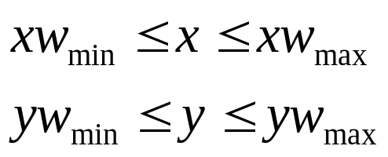
Point Clipping
yw_{max}
If P(x,y) is inside the window?
P(x,y)
yw_{min}
xw_{min}
xw_{max}

Slide 12
Line clipping
Line clipping procedure
  test a given line segment to determine whether it lies completely inside the clipping window
  if it doesn’t, we try to determine whether it lies completely outside the window
  if we can’t identify a line as completely inside or completely outside, we must perform intersection calculations with one or more clipping boundaries

Slide 13
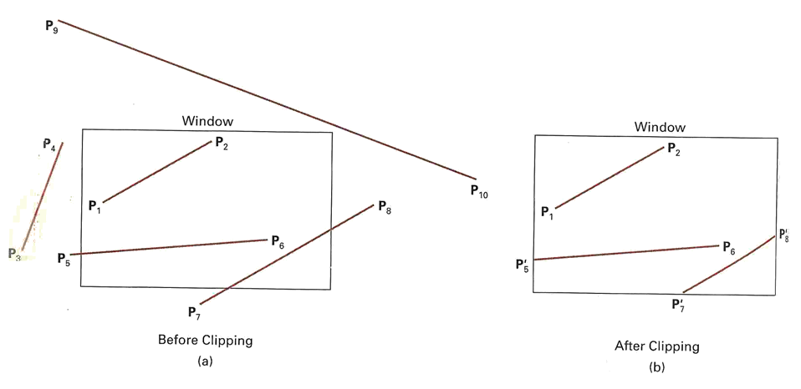
Line clipping
Checking the line endpoints ⇒ inside-outside test
Line clipping
  Cohen-Sutherland line clipping
  Liang-Barsky line clipping

Slide 14
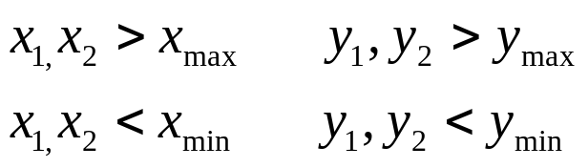
Cohen-Sutherland Algorithm
Divide the line clipping process into two phases:
  Identify those lines which intersect the clipping window and so need to be clipped.
  Perform the clipping
All lines fall into one of the following clipping categories:
  Visible: Both end points of the line lie within the window.
  Not visible: The line definitely lies outside the window. This will occur if the line from (x1,y1) to (x2,y2) satisfies any one of the following inequalities:
  Clipping candidate: the line is in neither category 1 nor 2

Slide 15
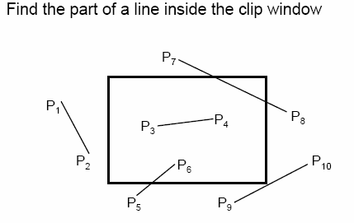



Cohen-Sutherland Algorithm
is in category 1(Visible)
is in category 2(Not Visible)
is in category 3(Clipping candidate)

Slide 16
Cohen-Sutherland Algorithm
ymax
∩
y < ymax
y > ymin
interior
=
ymin
xmin
xmax
x > xmin
x < xmax

Slide 17
Cohen-Sutherland Algorithm
Assign a four-bit pattern (Region Code) to each endpoint of the given segment. The code is determined according to which of the following nine regions of the plane the endpoint lies in.
  Of course, a point with code 0000 is inside the window.
1001
1000
1010
y_{max}
0001
0000
0010
y_{min}
0101
0100
0110
x_{min}
x_{max}
bit 1 : bit 2 : bit 3 : bit 4
Top : Bottom : Right : Left:

Slide 18
Cohen-Sutherland Algorithm
1001
1000
1010
y_{max}
0001
0000
0010
y_{min}
0101
0100
0110
x_{min}
x_{max}

Slide 19
Cohen-Sutherland Algorithm
if both endpoint codes are 0000 ➔ the line segment is visible (inside).
the logical AND of the two endpoint codes
  not completely 0000 ➔ the line segment is not visible (outside)
  completely 0000 ➔ the line segment maybe inside (and outside)
Lines that cannot be identified as being completely inside or completely outside a clipping window are then checked for intersection with the window border lines.

Slide 20
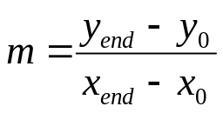
Cohen-Sutherland Algorithm
D
Consider code of an end point
  if bit 1 is 1, intersect with line y = Ymax
  if bit 2 is 1, intersect with line y = Ymin
  if bit 3 is 1, intersect with line x = Xmax
  if bit 4 is 1, intersect with line x = Xmin
Consider line CD.
  If endpoint C is chosen, then the bottom boundary line Y=Ymin is selected for computing intersection
  If endpoint D is chosen, then either the top boundary line Y=Ymax or the right boundary line X=Xmax is used.
  The coordinates of the intersection point are:
    y = y0 + m(x-x0)
    x = Xmax or Xmin if the boundary line is vertical or
    x = x0 + 1/m(y-y0) Xmin if the boundary line is horizontal
    Y= Ymax or Ymin , Where
F
C
y_{max}
B
E
J
A
L
J’
I’
K
H
y_{min}
H’
I
G’
G
x_{min}
x_{max}

Slide 21
Cohen-Sutherland Algorithm
Replace endpoint (x1,y1) with the intersection point(xi,yi), effectively eliminating the portion of the original line that is on the outside of the selected window boundary.
The new endpoint is then assigned an updated region code and the clipped line re-categoriged and handled in the same way.
This iterative process terminates when we finally reach a clipped line that belongs to either category 1(visible) or category 2(not visible).

Slide 22
Cohen-Sutherland Line Clipping
Use Simple Tests to Classify Easy Cases First
P₇
P₁
P₄
P₈
P₃
P₂
P₆
P₁₀
P₅
P₉
cgvr.korea.ac.kr

Slide 23
Cohen-Sutherland Line Clipping
Classify Some Lines Quickly by AND of Bit Codes Representing Regions of Two Endpoints (Must Be 0)
1001
P₇
0001
0101
Bit 4
P₁
P₄
P₈
1000
P₃
0000
0100
P₂
P₆
P₁₀
Bit 3
1010
P₅
0010
P₉
0110
Bit 1
Bit 2
cgvr.korea.ac.kr

Slide 24
Cohen-Sutherland Line Clipping
Classify Some Lines Quickly by AND of Bit Codes Representing Regions of Two Endpoints (Must Be 0)
1001
P₇
0001
0101
Bit 4
P₁
P₄
P₈
1000
P₃
0000
0100
P₂
P₆
P₁₀
Bit 3
1010
P₅
0010
P₉
0110
Bit 1
Bit 2
cgvr.korea.ac.kr

Slide 25
Cohen-Sutherland Line Clipping
Classify Some Lines Quickly by AND of Bit Codes Representing Regions of Two Endpoints (Must Be 0)
1001
P₇
0001
0101
Bit 4
P₄
P₈
1000
P₃
0000
0100
P₆
P₁₀
Bit 3
1010
P₅
0010
P₉
0110
Bit 1
Bit 2
cgvr.korea.ac.kr

Slide 26
Cohen-Sutherland Line Clipping
Compute Intersections with Window Boundary for Lines That Can’t be Classified Quickly
1001
P₇
0001
0101
Bit 4
P₄
P₈
1000
P₃
0000
0100
P₆
P₁₀
Bit 3
1010
P₅
0010
P₉
0110
Bit 1
Bit 2
cgvr.korea.ac.kr

Slide 27
Cohen-Sutherland Line Clipping
Compute Intersections with Window Boundary for Lines That Can’t be Classified Quickly
1001
P₇
0001
0101
Bit 4
P₄
P₈
1000
P₃
0000
0100
P₆
P₁₀
Bit 3
1010
P₅
0010
P₉
0110
Bit 1
Bit 2
cgvr.korea.ac.kr

Slide 28
Cohen-Sutherland Line Clipping
Compute Intersections with Window Boundary for Lines That Can’t be Classified Quickly
1001
P₇
0001
0101
Bit 4
P₄
P₈
1000
P₃
0000
0100
P₆
P₁₀
Bit 3
P’₅
1010
0010
P₉
0110
Bit 1
Bit 2
cgvr.korea.ac.kr

Slide 29
Cohen-Sutherland Line Clipping
Compute Intersections with Window Boundary for Lines That Can’t be Classified Quickly
1001
P₇
0001
0101
Bit 4
P₄
P₈
1000
P₃
0000
0100
P₆
P₁₀
Bit 3
P’₅
1010
0010
P₉
0110
Bit 1
Bit 2
cgvr.korea.ac.kr

Slide 30
Cohen-Sutherland Line Clipping
Compute Intersections with Window Boundary for Lines That Can’t be Classified Quickly
1001
P₇
0001
0101
Bit 4
P₄
P₈
1000
P₃
0000
0100
P₆
P₁₀
Bit 3
P’₅
1010
0010
P₉
0110
Bit 1
Bit 2
cgvr.korea.ac.kr

Slide 31
Cohen-Sutherland Line Clipping
Compute Intersections with Window Boundary for Lines That Can’t be Classified Quickly
1001
P₇
0001
0101
Bit 4
P₄
P₈
1000
P₃
0000
0100
P₆
P₁₀
Bit 3
P’₅
1010
0010
P₉
0110
Bit 1
Bit 2
cgvr.korea.ac.kr

Slide 32
Cohen-Sutherland Line Clipping
Compute Intersections with Window Boundary for Lines That Can’t be Classified Quickly
1001
0001
P’₇
0101
Bit 4
P₄
P₈
1000
P₃
0000
0100
P₆
P₁₀
Bit 3
P’₅
1010
0010
P₉
0110
Bit 1
Bit 2
cgvr.korea.ac.kr

Slide 33
Cohen-Sutherland Line Clipping
Compute Intersections with Window Boundary for Lines That Can’t be Classified Quickly
1001
0001
P’₇
0101
Bit 4
P₄
P₈
1000
P₃
0000
0100
P₆
P₁₀
Bit 3
P’₅
1010
0010
P₉
0110
Bit 1
Bit 2
cgvr.korea.ac.kr

Slide 34
Cohen-Sutherland Line Clipping
Compute Intersections with Window Boundary for Lines That Can’t be Classified Quickly
1001
0001
P’₇
0101
Bit 4
P₄
P’₈
1000
P₃
0000
0100
P₆
P₁₀
Bit 3
P’₅
1010
0010
P₉
0110
Bit 1
Bit 2
cgvr.korea.ac.kr

Slide 35
Cohen-Sutherland Line Clipping
Compute Intersections with Window Boundary for Lines That Can’t be Classified Quickly
1001
0001
P’₇
0101
Bit 4
P₄
P’₈
1000
P₃
0000
0100
P₆
P₁₀
Bit 3
P’₅
1010
0010
P₉
0110
Bit 1
Bit 2
cgvr.korea.ac.kr

Slide 36
Cohen-Sutherland Line Clipping
Compute Intersections with Window Boundary for Lines That Can’t be Classified Quickly
1001
0001
P’₇
0101
Bit 4
P₄
P’₈
1000
P₃
0000
0100
P₆
P₁₀
Bit 3
P’₅
1010
0010
P₉
0110
Bit 1
Bit 2
cgvr.korea.ac.kr

Slide 37
Cohen-Sutherland Line Clipping
Compute Intersections with Window Boundary for Lines That Can’t be Classified Quickly
1001
0001
P’₇
0101
Bit 4
P₄
P’₈
1000
P₃
0000
0100
P₆
P₁₀
Bit 3
P’₅
1010
0010
P₉
0110
Bit 1
Bit 2
cgvr.korea.ac.kr

Slide 38
Cohen-Sutherland Line Clipping
Compute Intersections with Window Boundary for Lines That Can’t be Classified Quickly
1001
0001
P’₇
0101
Bit 4
P₄
P’₈
1000
P₃
0000
0100
P₆
P₁₀
Bit 3
P’₅
P’₉
1010
0010
0110
Bit 1
Bit 2
cgvr.korea.ac.kr

Slide 39
Cohen-Sutherland Line Clipping
Compute Intersections with Window Boundary for Lines That Can’t be Classified Quickly
1001
0001
P’₇
0101
Bit 4
P₄
P’₈
1000
P₃
0000
0100
P₆
P₁₀
Bit 3
P’₅
P’₉
1010
0010
0110
Bit 1
Bit 2
cgvr.korea.ac.kr

Slide 40
Cohen-Sutherland Line Clipping
Compute Intersections with Window Boundary for Lines That Can’t be Classified Quickly
1001
0001
P’₇
0101
Bit 4
P₄
P’₈
1000
P₃
0000
0100
P₆
Bit 3
P’₅
1010
0010
0110
Bit 1
Bit 2
cgvr.korea.ac.kr

